Slide 1



NEWYORK CITY
TRAFFIC COLLISION
ANALYSIS
Presented By Ahmed H. Shaalan

Slide 2


CONTENT
Goals and Objectives
Overview On Workflow
Data Sources
Steps of Workflow
Data Modeling
Summary

Slide 3



GOALS AND OBJECTIVES
01
Deep Understanding of data sources
02
Practicing some data manipulation processes using different python libraries
03
Building End-to-end Integrated Workflo

Slide 4







OVERVIEW ON WORKFLOW
END-TO-END PROJECT WORKFLOW
Extraction
Exploration
Preparation
Combination
Transformation
Analysis
Using Python Packages to extract data from different data sources
Getting some information about the data so it is key of decisions for data preparation and transformation
Some preparation of data so it can be in right format that helps to more investigation and processing for data
Gathering all prepared datasets together to have full form for dataset and it will be ready for more cleansing and transformation
Data Transformation and cleansing so we can drop the missing values and create new fields that will be very helpful in analyzing the transformed dataset
The insights that help business and organizations to make decisions to avoid the more errors and defects.
More insights, More Understanding and More good decisions

Slide 5



DATA SOURCES
NYC Traffic Collisions Dataset
“Motor Vehicle Collisions – Crashes”
This dataset contains details for each reported motor vehicle collision event in New York City.
Public Holidays Dataset
This API provides the dates and names of public holidays for a given year and country

Slide 6

WORKFLOWSTEP 1
DATA EXTRACTION
Data Source 1
NYC Traffic Collisions Dataset
Data Source 2
Public Holidays Dataset
NYC Traffic Collisions
“Motor Vehicle Collisions – Crashes”
It is Public Dataset as CSV file downloaded
“Public Holidays in NYC”
Dager.ai API: This is API called which has public holidays of specific country within specific Year
Extract this data using python library called pandas with method read_csv
Convert it into Pandas Dataframe.
Extract this data using python library called requests responsible for get https requests
Convert it into JSON using python library called json
Convert it into Pandas Data frame.
File Limitations
API Limitations
This Files contains many years, so it is very large to process.
This API only takes one year as an input in the url.
Handling Limitations
Handling Limitations
Extracting data by sampling within specific years that fall within a definite range.
Iterating through the API over multiple years in each pass, allowing us to dynamically extract all public holidays.

Slide 7

WORKFLOWSTEP 2
DATA EXPLORATION
Data Source 1
NYC Traffic Collisions Dataset
Data Source 2
Public Holidays Dataset
NYC Traffic Collisions
This dataset contains some information about collisions and crashes in New York City as:
This dataset contains some information about Public Holidays in United States of America as:
Date and Time of Collisions
Location of Collisions
Types of Vehicles involved in the collision
Types of Contributing factors of the vehicles involved in the collision
Number of Injuries and kills in each collision
The Holiday Date
Holiday Name
Types of Holidays
The counties that have each holiday.
Some Data Exploration processes have been made on this dataset to better understanding the effective fields
Some Data Exploration processes have been made on this dataset to better understanding the effective fields
Data Types
How many records and columns
the column names
Number of missing values and percentage of them in each column
Retrieving the unique values in each column
Data Types of Columns
the shape of data
Columns’ Names
Duplicates Check
What are the public holidays specified for New York City

Slide 8
WORKFLOWSTEP 3
DATA PREPARATION
Data Source 1
NYC Traffic Collisions Dataset
Data Source 2
Public Holidays Dataset
NYC Traffic Collisions
Due to some data exploration results, there are some preparations as:
Due to some data exploration results, there are some preparations as:
Columns’ Names will be renamed.
Date and Time Columns will be reformatted.
Converting Data and Time Column’s Types.
Creating new columns for hour, day name, month name and year
Data Types converting to be in proper format and type
Data Sampling if it is needed to work on smaller sample of data to reduce the heavy processing.
Columns’ Names will be renamed.
Date Column will be reformatted.
Converting Data Column’s Types.
Concatenation of all public holidays of all years together in one dataset for public holidays.
Removing the duplicates of Days
Choosing only Public Holidays of New York City.

Slide 9
WORKFLOWSTEP 4
DATA COMBINATION
Now we have two prepared datasets which are ready to be combined together on date columns.
left join for the two datasets using pandas.merge with left:
the left dataset will be the crashes and collisions in New York City
the right dataset will be the public holidays
That will generate combined dataset, which is ready for cleansing, transformations and creating new fields that help with the analysis in the final result.
THE JOINING:
Left Table:
Collisions and Crashes
Right Table:
Public Holidays
Crash date
Holiday Date

Slide 10
WORKFLOWSTEP 5
DATA CLEANSING AND TRANSFORMATION
Now we have two prepared datasets which are combined together, assuming that we can understand:
How Public Holidays affect the number of collisions in New York City.
How the number of collisions is affected by weekdays.
If the number of collisions differs over years and how it is affected by Pandemic.
Number of collisions within Boroughs in New York City.
So, some cleansing and Transformation processes will take place on this dataset.
Locations Manipulation:
There are many missing boroughs up to 30.89%
So, we need to get another dataset for boroughs in New York city to fill these missing boroughs.
After Imputation, Percentage reached 11.1%
Dropping invalid locations which have (0.0,0.0) values and with no boroughs and no zip codes.
Percentage of missing boroughs reached 2.1%
Dropping the NaN values with this small percentage does not affect the main dataset.
Percentage of missing boroughs reached 0.0%
New Fields Creation:
Holidays:
Creating new flag called (is_public_holiday) to identify if this date is public holiday or not.
Severity:
calculating total number of injuries (total_injured)
calculating total number of kills (total_killed)
Upon those fields we can determine the severity of collisions : fatal , Injury and No Casualty

Slide 11

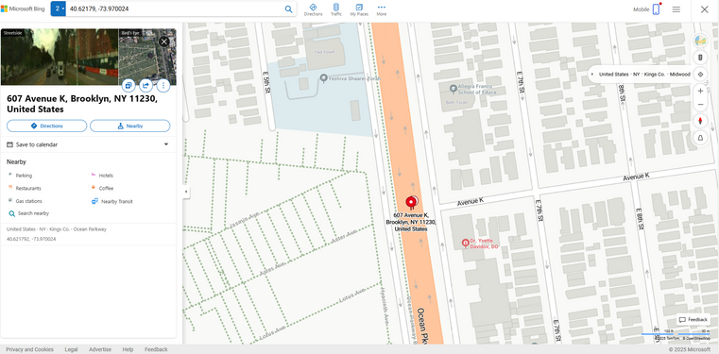
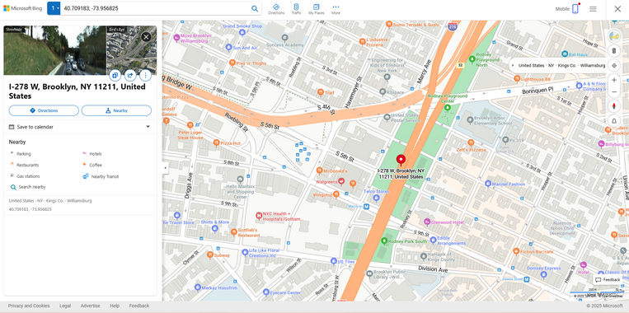
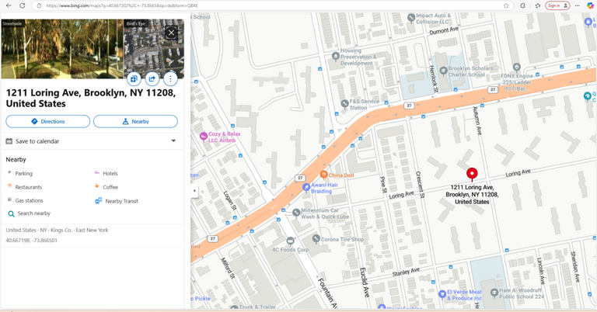
WORKFLOWSTEP 5
DATA CLEANSING AND TRANSFORMATION
(CONTINUED)
Depending on the type of streets so we can get which has more collisions in boroughs.
Creating new flag called (location_type) to identify if it is intersection, mid-block or off-street
Intersection
Mid-block
Off-street
Cleansing process on contributing factors in accidents so government can take more action due to these reasons.
Dropping all the records that have all missing values in their location’s columns.

Slide 12
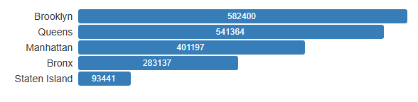
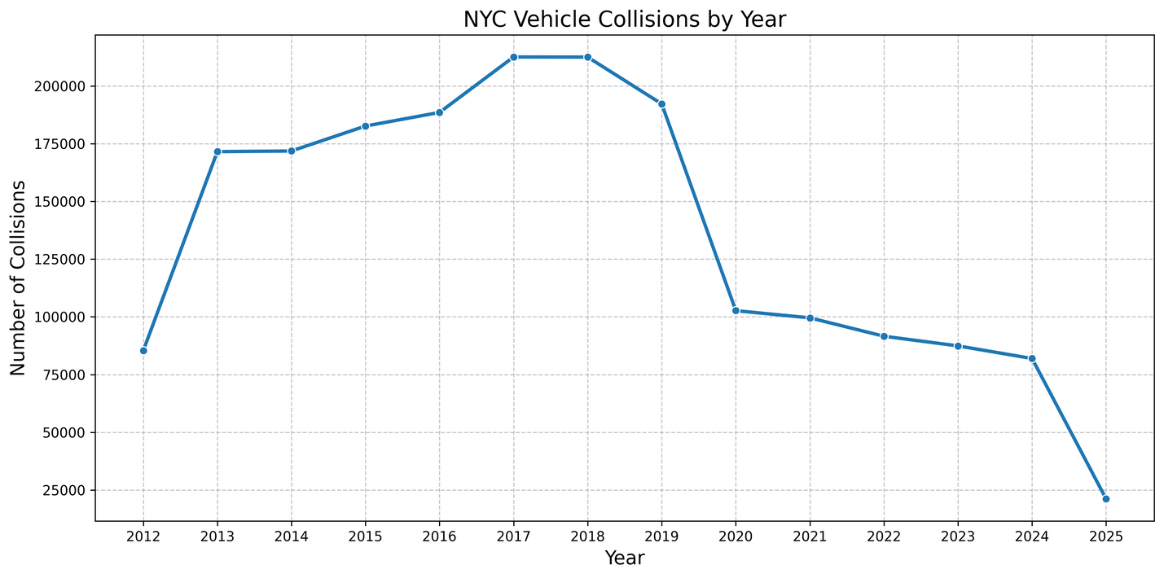
WORKFLOWSTEP 6
ANALYSIS
Number of collisions within Boroughs in New York City.
If the number of collisions differs over years and how it is affected by Pandemic.

Slide 13
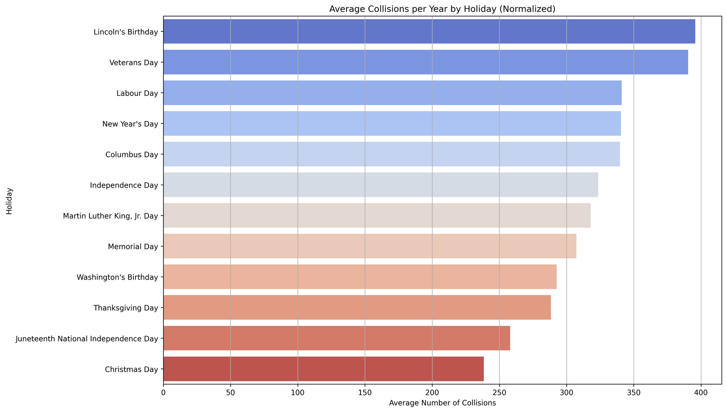
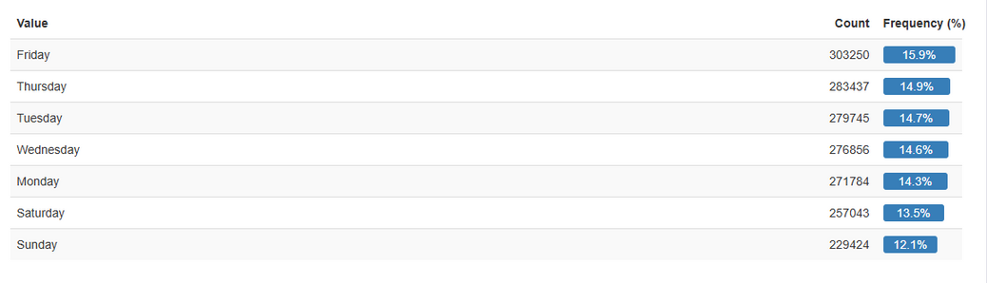
WORKFLOWSTEP 6
ANALYSIS
(CONTINUED)
How Public Holidays affect the number of collisions in New York City.
How the number of collisions is affected by weekdays.

Slide 14
DATA
MODEL
Data
Data Model is created using some functions
star schema
Fact Table
Main Cleaned and Merged Final Table
Foreign Keys Created for each Dimension using mapping
Drop the descriptions
Dimensions
Contributing Factors
only one dimension for all 5 factors
Vehicle Types
only one dimension for all 5 types
Location Type
Severity levels
Boroughs
Public Holidays
we can also create dimensions for days, and months
Contributing Factors
cf1_id
Severity levels
cf2_id
severity_id
cf3_id
cf4_id
cf5_id
Vehicle Types
v1_id
borough_id
Boroughs
v2_id
v3_id
v4_id
v5_id
Fact Table: MainTable_df
Location Type
Public Holidays
location_type_id
date

Slide 15
SUMMARY
According to Deep Analysis:
Lincoln's birthday on 12nd February is the highest number of collisions in public holidays every year.
Brooklyn has the highest number of collisions while Staten Island has the lowest one.
The number of collisions decreased by 50% in 2020 due to the COVID pandemic as there are many workers and students are working and studying from their home.
Friday has the highest number of collisions in the weekdays.
you can find an end-to-end integrated workflow on this GitHub repository:
https://github.com/AhmedHShaalan/NYC_Project

Slide 16

THANKS

